Slide 1

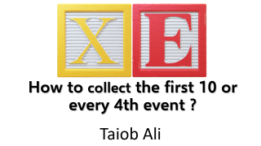

How to collect the first 10 or every 4th event ?
Taiob Ali

Slide 2
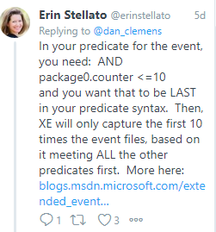
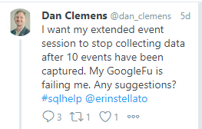

Slide 3
Predicate
Global
Predicate Source
Local
Event Field

Slide 4
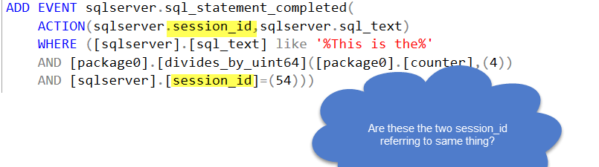
Check if Action Enabled
Collect EventData
Analyzed Predicate
Collect Action Data
Publish
Notes:
No
Filter session_id is on predicate source and once it evaluate to true, action session_id will get added to my result set.

Slide 5
package_name.pred_compare(field/pred_source, value)
package0.divides_by_uint64(package0.counter,4)

Slide 6
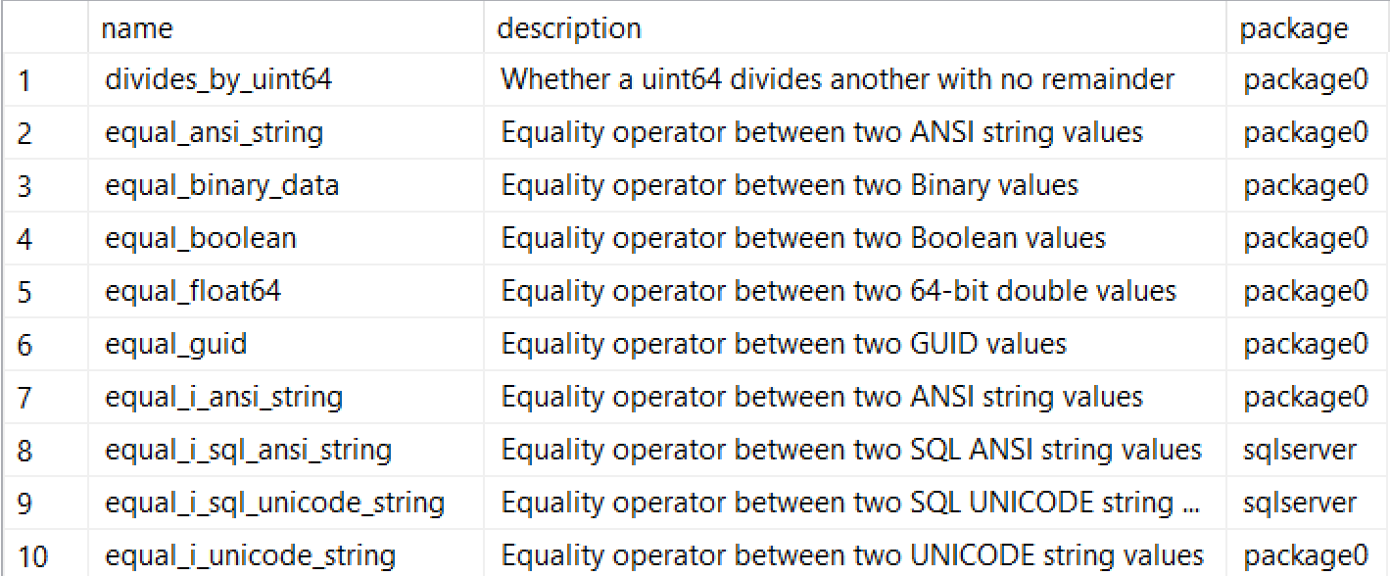
Notes:
These are called Predicate Comparator in short called pred_compare
See script for details.

Slide 7


Slide 8
Resource
Try a sample: Using the counter predicate for event sampling
Today’s Subject: Predicates
Reading event data 101: What’s up with the XML?
Why I hate the ring_buffer target in Extended Events

Slide 9
Work
Outside Work
Giving Back
Running—One 26.2 and Many 13.1
Microsoft MVP – Data Platform
Shuttling 3 kids
Organizer @SqlSaturdayBoston and Co-organizer NESQL UG
13 years as DBA
MCSE Data Management and Analytics
Frequent speaker local user groups, SQL Saturdays & Virtual groups
Answering questions at #sqlhelp & dba.stackexchange
Blog at sqlworldwide.com

Slide 10





@SqlWorldWide
linkedin.com/in/taiobali
sqlworldwide.com
taiob@sqlworldwide.com

Slide 11


